Slide 1
OEA-PIE
An essential part of a
public education diet.

Slide 2
OEA-PIE
What IS it?

Slide 3
PIE means People for the Improvement of Education. PIE is a political action committee (PAC) of the Oregon Education Association (OEA).
OEA uses the money in this PAC to financially support political candidates who are pro-public education.
*OEA dues are never used for any candidate’s campaign. That is forbidden according to OEA bylaws.

Slide 4
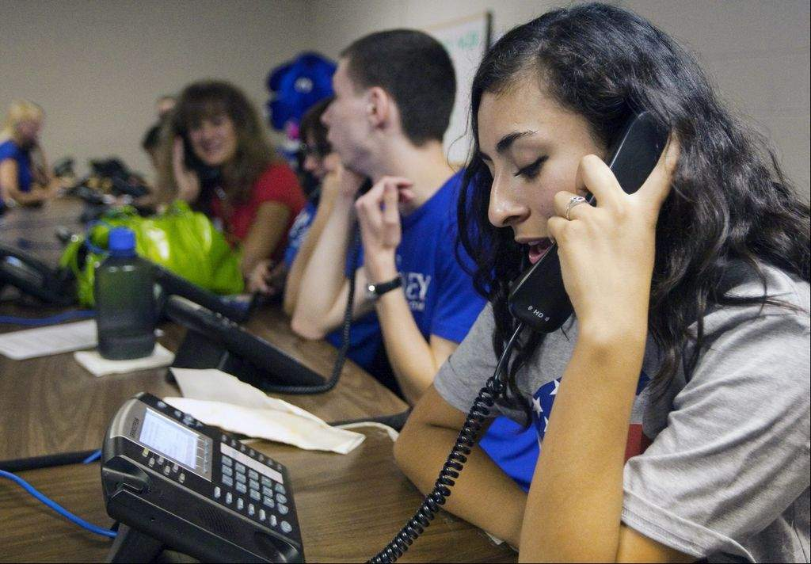
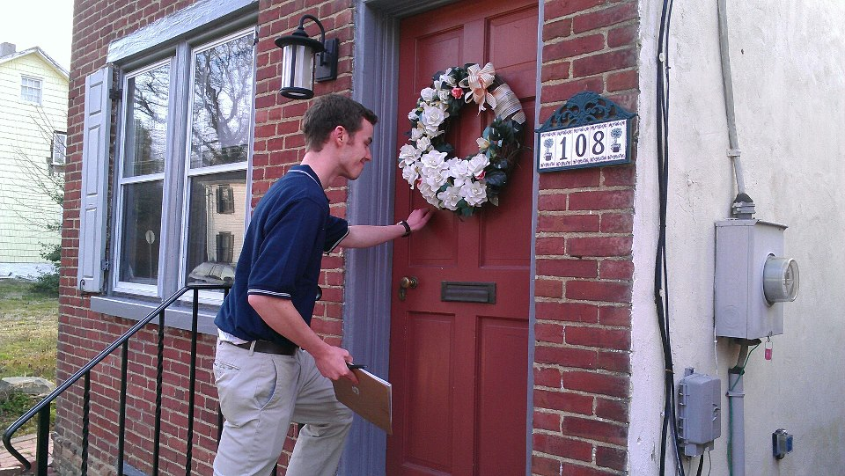
If you do not enjoy volunteering for a phone bank or canvassing for political candidates, donating to OEA-PIE is the single most effective way you can help elect pro-public education candidates.

Slide 5
OEA’s “Measure Up” Criteria
What does OEA look for in a candidate?

Slide 6
OEA endorsed candidates will work to:
• protect children's health and safety
secure stable school funding and strengthen public schools
support programs that prepare students for jobs of the future
ensure the rights of public school employees

Slide 7
OEA endorsement decisions are based on a questionnaire completed by the candidates and an interview with OEA-PIE contributors.
OEA only considers endorsing candidates who have applied for the endorsement. Not every candidate seeks OEA’s political endorsement.
In 2016, OEA gave no recommendation in eighteen races based on the responses of the candidates.

Slide 8
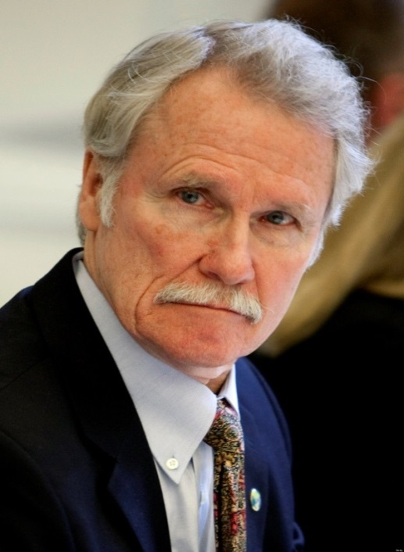
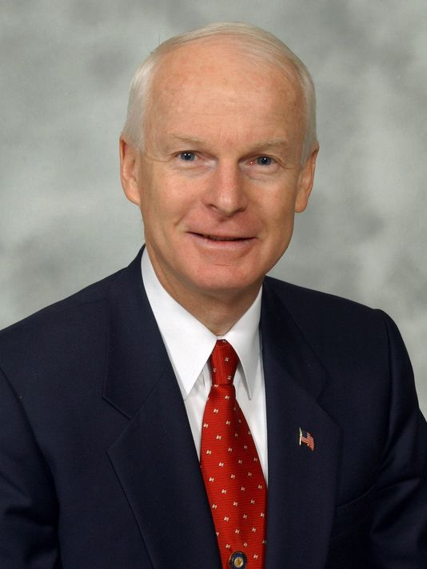
2014 Oregon Gubernatorial
Primary Election
OEA voted not to endorse Democrat John Kitzhaber due to his job performance.
Republican Rep. Dennis Richardson chose not to seek OEA’s endorsement.

Slide 9
Why should I contribute?

Slide 10
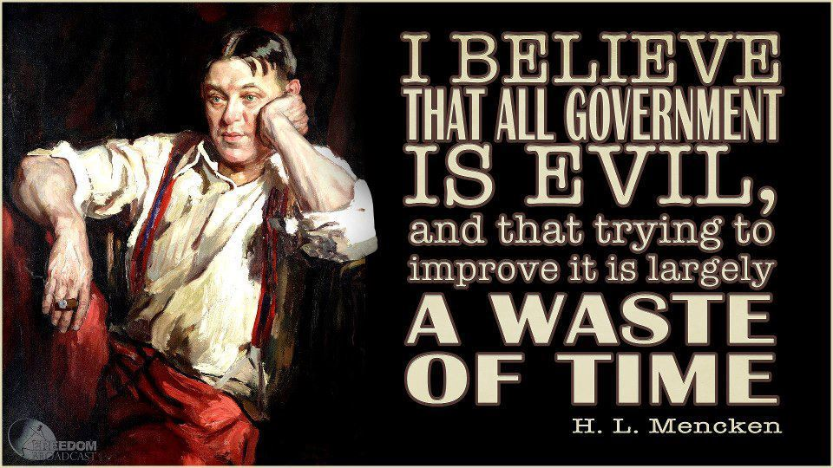
I am NOT a political person.
I just want to teach and not worry about politics.

Slide 11
Education is and will always be political.
You can’t avoid it!
Politics influences almost every area of education today.
- public school funding
- class size
- high stakes student testing
- Common Core (love it or hate it, it’s here)
- teacher evaluations
- salaries and benefits
- retirement (PERS)

Slide 12
Teachers can no longer afford to sit on the sidelines and hope that the Legislature will adequately fund education or look out for our interests.
Teachers must not only take an interest in politics and vote, teachers must become politically pro-active.
NO ONE will look out for your interests if you do not.

Slide 13
I am not sure I want to donate, because . . .

Slide 14
sometimes I do not like the candidates that NEA endorses.
You do not have to donate money to NEA.
You may choose to donate to only OEA.

Slide 15
I am not sure I want to contribute to a pro-public education candidate who does not believe the same as I do on another issue, such as abortion or gun control.

Slide 16
It is rare that there will be THE perfect candidate with whom you agree on all of the issues.
Education
Taxes
Social Services
Gun Control
Immigration
Abortion
Death Penalty
Health Care
Environment
Marijuana Legalization
Gay Marriage
Foreign Policy
Defense Spending
Ask which candidate is most likely to have a positive effect on student learning, your working conditions, pay, health care, and retirement?

Slide 17
Why should I donate money to OEA-PIE when some of the candidates OEA has endorsed have not backed teachers?

Slide 18
Just because you donate to a political candidate does not mean they will always do 100% of what you want.

Slide 19
I am not sure about donating, because I feel OEA only endorses Democrats.
I vote for the candidate, not the party.

Slide 20
It is a myth that OEA only endorses Democratic candidates.
OEA invites all candidates, regardless of party affiliation to participate in the recommendation process. Some GOP candidates choose not to apply.
OEA has endorsed many Republicans in the past. Here are endorsed Republicans in just the last election.

Slide 21
OEA-PIE ENDORSED REPUBLICANS
IN 2016
State – Oregon Senate
SD 01 | Jeff Kruse (R) | SD 02 | Herman Baertschinger (R)
SD 09 | Fred Girod (R) | SD 27 | Tim Knopp (R)
State – Oregon House of Representatives
HD 15 | Andy Olson (R) | HD 39 | Bill Kennemer (R)
HD 53 | Gene Whisnant (R)

Slide 22
How much should I contribute?

Slide 23
If you donate $50 to OEA-PIE, you will receive a $50 TAX CREDIT. That means you will receive $50 back when you file your state income tax returns.
If you and your spouse donate $100, you will receive a $100 TAX CREDIT as a couple when you file your taxes together.
The amount of your donation will be divided over twelve months and deducted from your paycheck.

Slide 24
If you donate $50, that is only $4.16 per month.
For less than the price of one coffee drink or one fast food meal a month, you can help improve our influence with the Oregon Legislature.

Slide 25
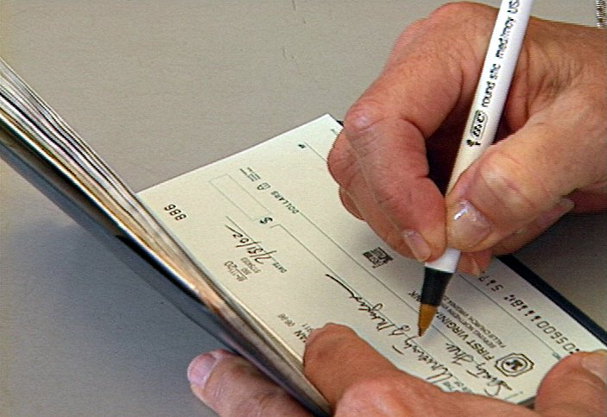
You may write a personal check rather than having a monthly payroll deduction, if you prefer.
You are entitled to one vote at the OEA-PIE convention for every $5 you contribute. You personally can help decide which candidate deserves the OEA endorsement.

Slide 26
Your PIE contribution will not cost you anything, because you get it all back when you file your state income taxes.
Think of this money more as a loan.
WHY would you NOT loan someone $4.16 a month who is working hard for you?

Slide 27
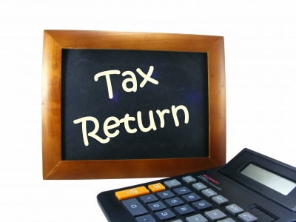
Near the end of the calendar year, OEA will send you a receipt for your donation as a reminder for you to declare it on your state income tax returns.

Slide 28
The proof is in the PIE!

Slide 29
OEA would not ask for your hard-earned money if it did not get results.
Here is how previous PIE contributors have helped improve public education.
-helped elect Ben Unger who has moved the discussion around local tax abatements helping put $10 million back in Washington county schools
-helped elect Chris Gorsek, an OEA member, who has been a true advocate for us in Salem
-worked to fix the proficiency standards for our classrooms (HB 4150 – eliminated redundant reporting)
-passed a bill to accurately measure class size by classroom (HB 2644)

Slide 30
OEA-PIE RESULTS
-the K-12 budget increased by over $ 1 billion from the last biennium
-passed M66 and M67 helping lessen the effects of the economic crash
Passed CTE

Slide 31
Those are all past successes.
What are YOU going to do to help achieve future successes for yourself and Oregon?
The future is NOW!
Sign-up for PIE!

Slide 32
If you are still unsure if you want to help elect pro-public education candidates or if you have any unanswered questions, please speak with your building representative or union leadership.
President – Jill Golay (Free Orchards ES)
Vice President – Joe Vermeire (Miller South MS)
Secretary – JoAnn Conroy (Rosedale ES)
Treasurer – Barbara Wickham (Brown MS)
www.heaoea.org

